Slide 1
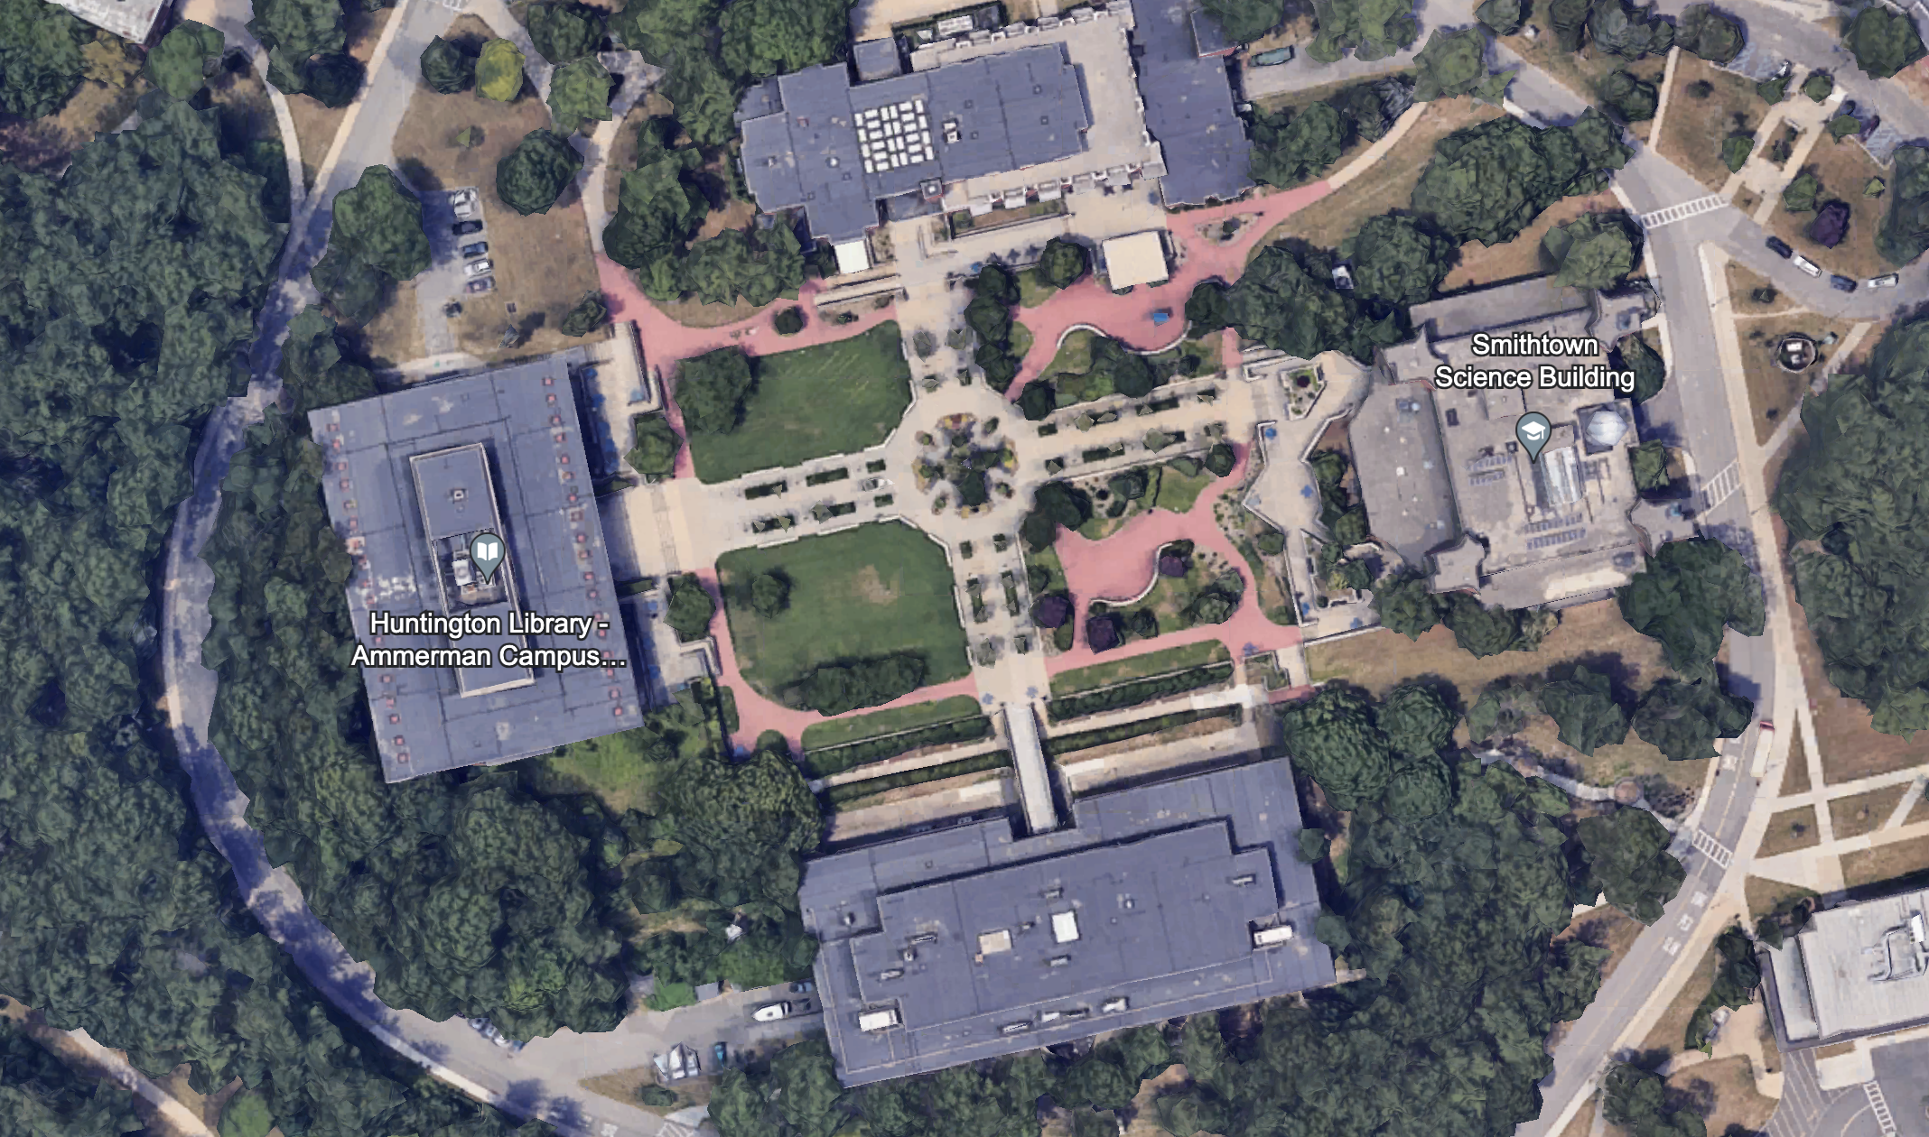
Sizes of planets and Sun are not to scale. Only distances need to be scaled.
Do not move the Sun, only drag N, J, E to the appropriate location according to the distance scale.
S
N
J
E

